Slide 1

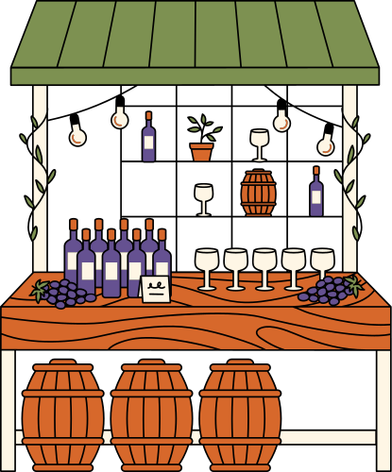
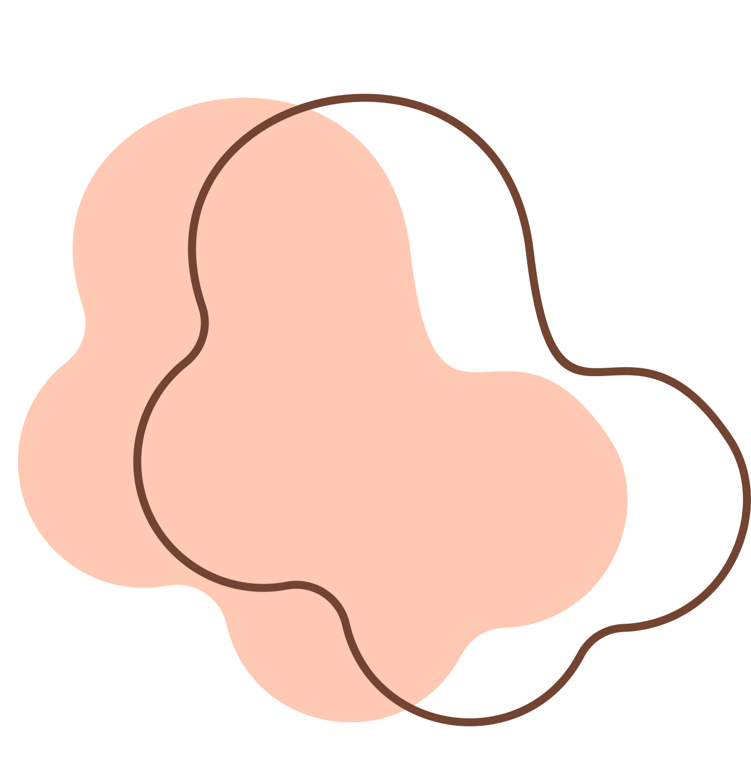
FINAL PROJECT
RED WINE QUALITY PREDICTION
Presented by: Mya Ei Win

Slide 2



INTRODUCTION
Dataset: Red Wine Quality (UCI Machine Learning Repository)​
Goal: Predict red wine quality score (regression) and high-quality label (classification)​
Used models: Linear, Logistic, MLP, Gradient Boosting​

Slide 3

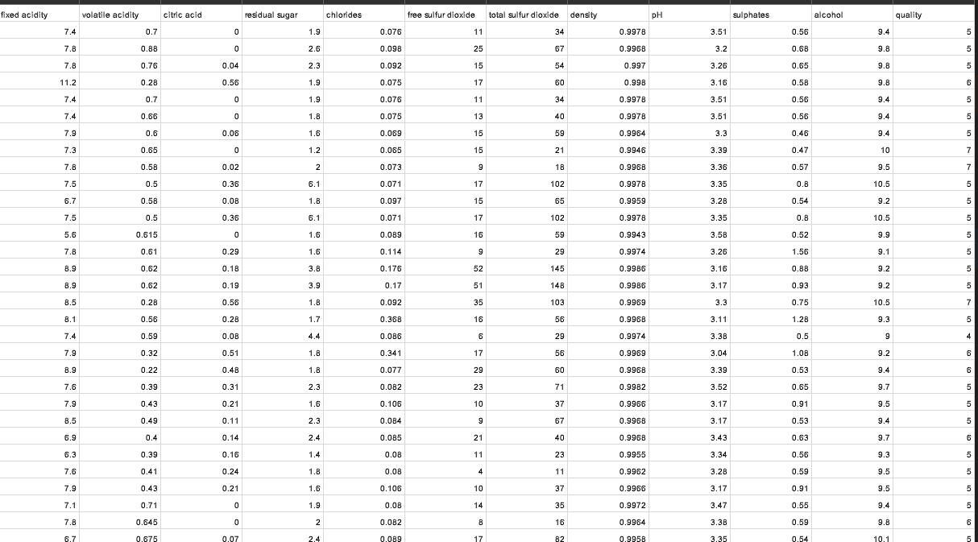
RED WINE DATASET

Slide 4

DATA PREPARATION
Loaded dataset from CSV​
Checked for and removed missing values​
Separated features and target (quality)​
Split into training and test sets (80/20)​

Slide 5

MODEL USED
Linear Regression & Logistic Regression (baseline models)
MLP Regressor & Classifier (neural network, tuned)
Gradient Boosting Regressor & Classifier (tree-based, tuned)

Slide 6

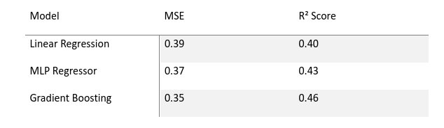
REGRESSION RESULTS
Gradient Boosting Regressor performed best:​
- Linear Regression: MSE = 0.390, R² = 0.403​
- MLP Regressor: MSE = 0.372, R² = 0.431​
- Gradient Boosting: MSE = 0.353, R² = 0.460​
Gradient Boosting handled non-linear relationships well.​

Slide 7
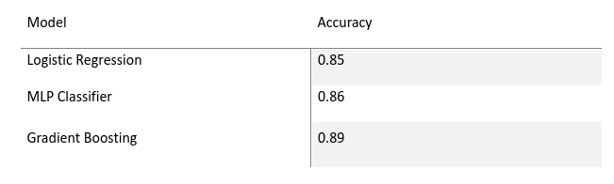
CLASSIFICATION RESULTS
Gradient Boosting Classifier achieved highest accuracy:​
- Logistic Regression: Accuracy = 0.85​
- MLP Classifier: Accuracy = 0.86​
- Gradient Boosting: Accuracy = 0.89

Slide 8


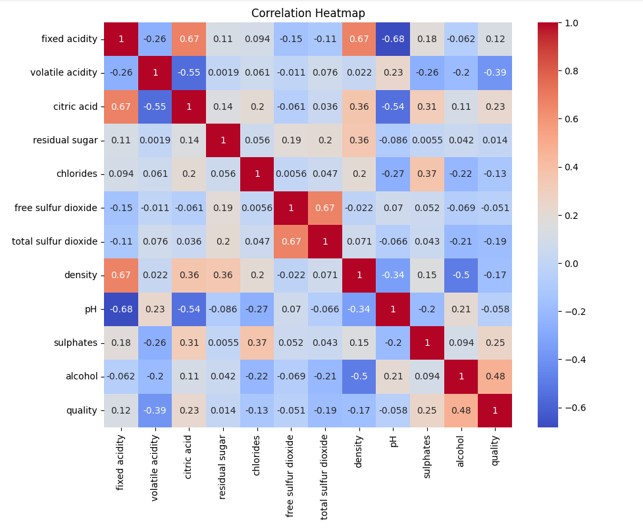
KEY VISUALS USED​
Correlation Heatmap: Alcohol had strongest positive correlation​

Slide 9
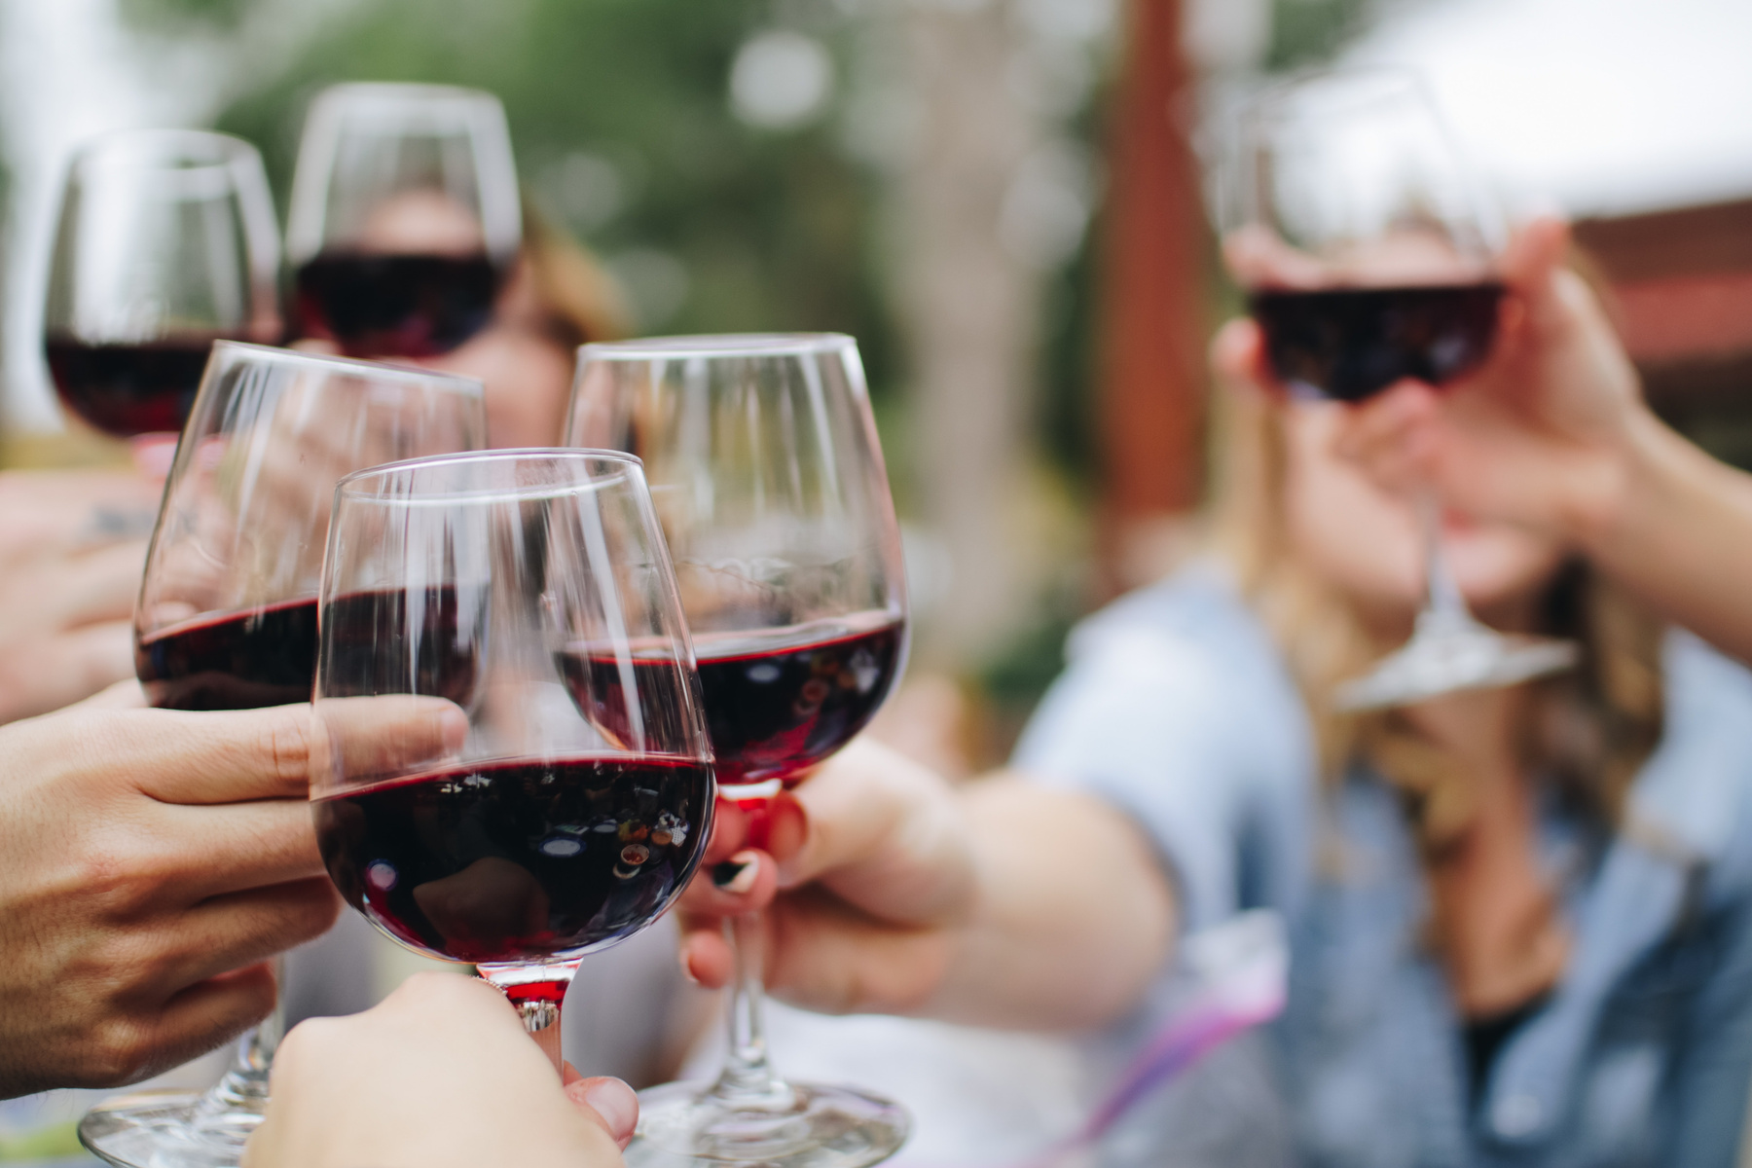
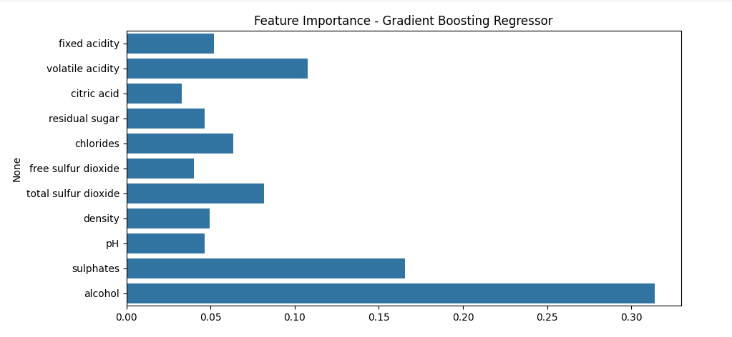
KEY VISUALS USED​
Feature Importance (Gradient Boosting): Alcohol, sulphates most important​

Slide 10
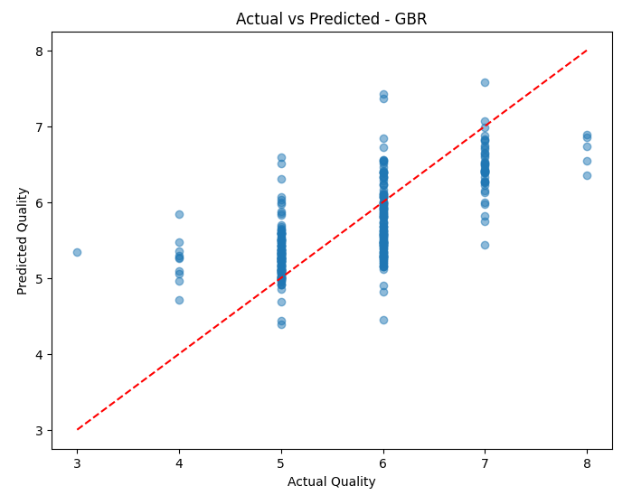
KEY VISUALS USED​
Actual vs Predicted Plot (GBR): Points close to ideal line​

Slide 11
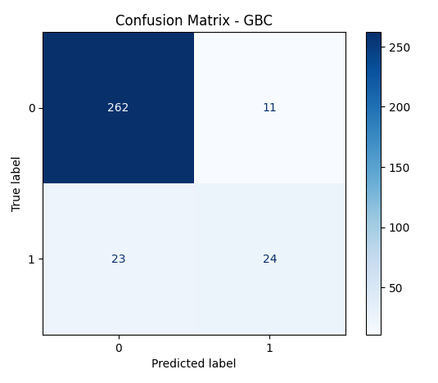
KEY VISUALS USED​
This matrix shows the model is really strong at identifying non-high-quality wines. It correctly labeled 262 of them.
For high-quality wines, it caught 24 out of 47.
So, while overall performance is good, there’s still room to improve that side.

Slide 12

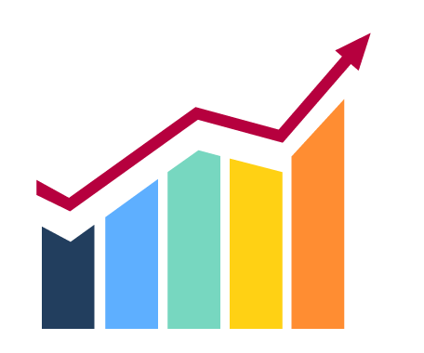
SUMMARY
Gradient Boosting performed best overall in both tasks​
MLP improved with tuning, but slower to train​
Linear and Logistic models were good baselines​

Slide 13

CONCLUSION & FUTURE WORK​
Learned how different models perform on the same dataset​
Gradient Boosting was most effective​
Future: handle class imbalance, tune tree depth, use full cross-validation​

Slide 14
REFERENCE
https://www.kaggle.com/datasets/uciml/red-wine-quality-cortez-et-al-2009/data
https://www.canva.com/

